Slide 1

A ROS implementation of a 6-DoF EKF for indoor drone Visual SLAM
Student: Diego Emanuel Avila
Advisor: Prof. Matteo Matteucci
Co-Advisor: Ing. Simone Mentasti
MSc. in Computer Science & Engineering
Dipartimento di Elettronica, Informazione e Bioingegneria
Notes:
Hello, my name is Diego Avila and I am presenting my thesis: A ROS implementation of a 6-DOF EKF for indoor drone Visual SLAM.

Slide 2
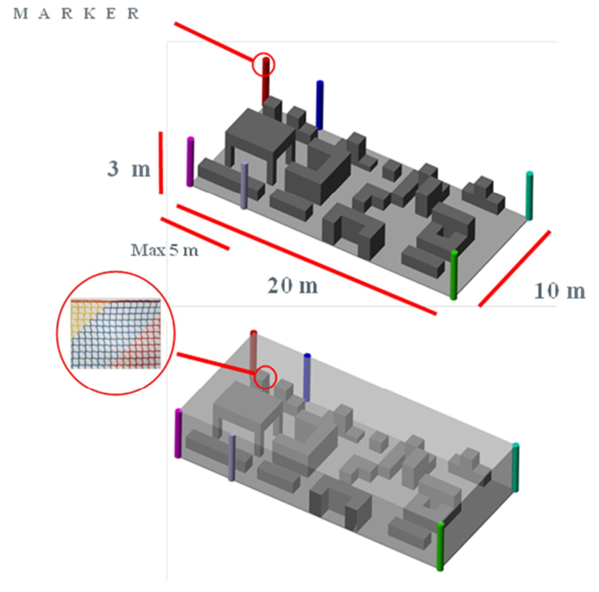
Leonardo Drone Contest
No GNSS nor Laser devices
Obstacles have at most 3 mts height with passages of at least 1 mt
Landmarks: colored poles and QR markers
Notes:
The implementation presented in this work should be framed in the context of the Leonardo Drone Contest held in Turin last September.
It involves a drone in an indoor environment that needed to be fully autonomous, and able FOLLOW a set of QR markers displaced in the environment, while avoiding static obstacles.
Only inertial devices, range sensors, speed sensors and cameras were allowed

Slide 3
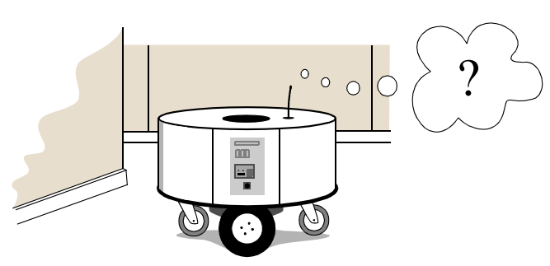
Simultaneous Localization and Mapping
Localization: where the robot is
Mapping: build a map of the environment
SLAM: localize itself while building a map
Notes:
In this context, we needed to tackle 2 problems:
localization, which is the problem of knowing the position of the robot,
and mapping, which is the problem of being able to build a map of the environment.
Localization and mapping are complex problems since they both depend on each other: to localize itself in the environment the robot needs a map, and to map the environment the robot needs to localize itself in it.
Nevertheless, a SLAM approach solves both problems at the same time, and due to the constraints imposed by the contest a Visual SLAM approach is the one used.

Slide 4
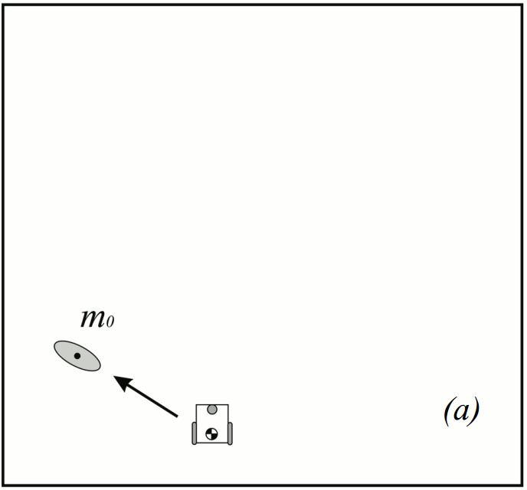

EKF-SLAM approach
Motion model: $g(u_{t},μ_{t−1})$
Observation model: $h({\hat{μ}}_{t})$
The full-state (map) is:
$μ={[q_{r} m_{0} ... m_{n−1}]}^{T}$
Builds feature-based maps
Notes:
We used an Extended Kalman Filter appoach since motion and observation processes for a robot are usually not-linear, and the EKF framework considers these non-linearities and linearize them using Taylor expansion
This way the motion model is represented by function g, which takes as parameters the control variable u, and the state vector \mu
Similarly, the observation model is represented by function h, and takes as parameter the estimated state produced by function g.
Hence, the full state vector contains not only the robot’s pose, but also the poses of all known markers.
As a result, this approach allows us to build feature based maps.

Slide 5
Proposed implementation
Notes:
So, regarding the implementation, and in the context of the competition...

Slide 6
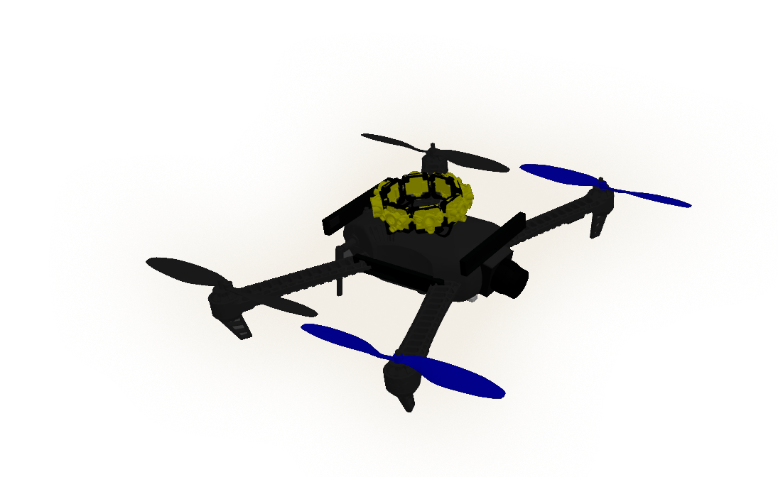
The drone
2 stereo cameras
PixHawk 4 Flight controller
Accelerometer + Gyroscope
Magnetometer
Barometer
4 monocular cameras
8 range sensor devices
1 optical flow device
Notes:
we used a drone with a PixHawk flight controller with inertial devices, but also
2 stereo cameras,
4 monocular cameras
1 optical flow device,
and 8 range sensors.
The 4 monocular cameras are displaced at 90 deg each, so to cover 360 degrees.

Slide 7
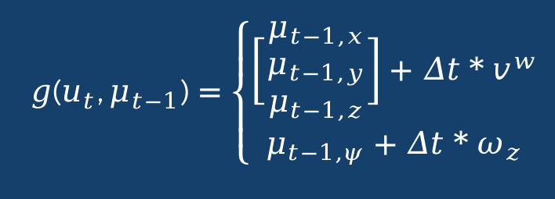
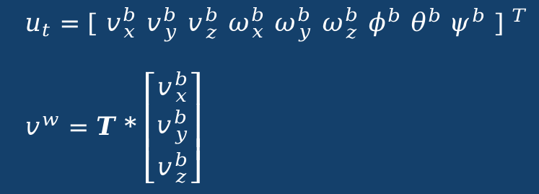
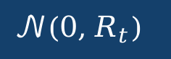
Control Variables
Motion Model
MAVROS node interfaces with the flight controller, and provides the control signal, which is composed by linear and angular velocities and the drone’s orientation
Given the linear velocities transformation, the motion model can be summarized as follow:
Noise in the motion process is assumed to be
Notes:
A MAVROS node interfaces the flight controller with the built SLAM ROS node.
The control variables of the process are: the linear and angular velocities of the drone, located in the body reference frame, and its orientation, estimated by the flight controller.
Given this, and after a transformation of the linear velocities to the world reference frame, the motion model becomes simply the integration of the velocities.
On the other hand, the EKF approach assumes the process noise to be Gaussian, with 0-mean and covariance R.
Covariance matrix R encodes the motion noise which, in this case, is related to the underlying dynamics of the drone flight.
This noise is the acceleration component, which is unknown but can be estimated at each time step.

Slide 8
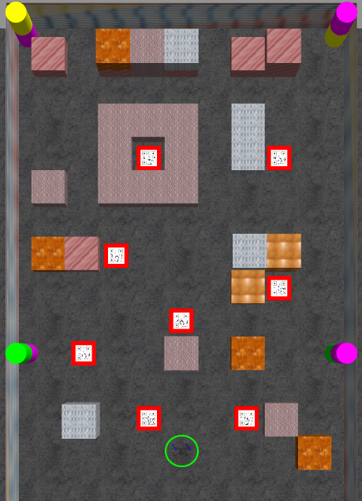

Observation Models
2 types of landmarks:
Poles
Markers
Observation for landmark i is
$$z_{i}=h_{i}(x_{t})+𝒩(0,Q_{t})$$
Notes:
The environment is 10 meters width by 20 meters length. It is delimited by net-like walls, with a pavement-like black floor, and the obstacles are made of a high visibility material.
Given the characteristics of the environment, 2 types of landmarks are used:
poles, which are known,
and markers which are unknown at the beginning.
As with the motion model, the observation noise is assumed to be Gaussian, 0-mean and with covariance Q.
However, in this case, the covariance matrices Q were obtained empirically.

Slide 9
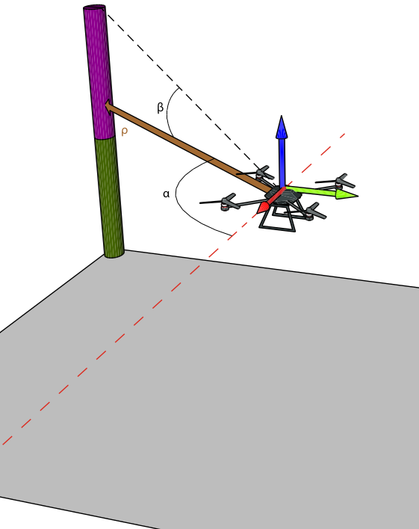

Poles’ Observation Models
Range and bearing information:
distance $ρ$
azimuth $α$
altitude $β$
$$\left[\begin{matrix}p_{i,x}^{b} \\ p_{i,y}^{b} \\ p_{i,z}^{b}\end{matrix}\right]={T_{r}}^{−1}*\left[\begin{matrix}p_{i,x}^{w} \\ p_{i,y}^{w} \\ p_{i,z}^{w}\end{matrix}\right]$$
$$h_{i}({\hat{μ}}_{t})=\left[\begin{matrix}p_{i,ρ}^{} \\ p_{i,α}^{} \\ p_{i,β}^{}\end{matrix}\right]=\left[\begin{matrix}\sqrt{p_{i,x^{b}}^{2}+p_{i,y^{b}}^{2}} \\ atan2(p_{i,y}^{b},p_{i,x}^{b}) \\ atan2(p_{i,z}^{b},p_{i,ρ}^{b})\end{matrix}\right]$$
Notes:
The Poles observation model builds range and bearing information, which would be: distance, azimuth angle and altitude angle, with respect the tip of the poles.
The observations are obtained from the monocular cameras, that identify the seen pole and publish the range and bearing information to the SLAM node.

Slide 10
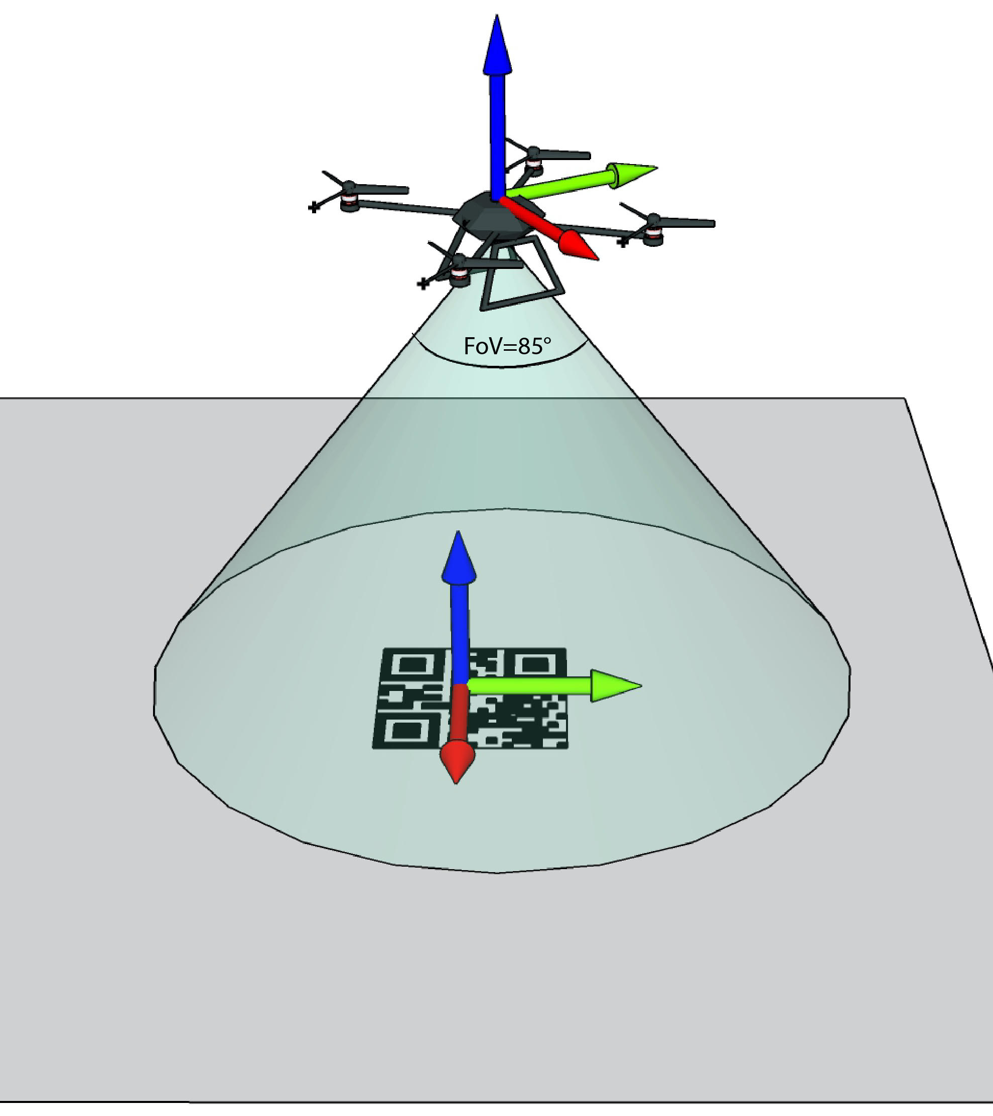

Markers’ Observation Model
Markers are unknown first, and added to the map once the drone sees them
Observations are composed by marker’s pose with respect to the camera reference frame
$$h_{i}({\hat{μ}}_{t})=\left[\begin{aligned}\begin{matrix}m_{i,x}^{c} \\ m_{i,y}^{c} \\ m_{i,z}^{c}\end{matrix} \\ m_{i,φ}^{c} \\ m_{i,θ}^{c} \\ m_{i,ψ}^{c}\end{aligned}\right]={\left(T_{r}*T_{c}\right)}^{−1}*T_{m}$$
Notes:
The observation model for the markers builds the markers’ pose in the camera reference frame.
The observations are obtained from a stereo camera that points to the floor, and estimates the marker’s pose with respect to the camera reference frame.

Slide 11
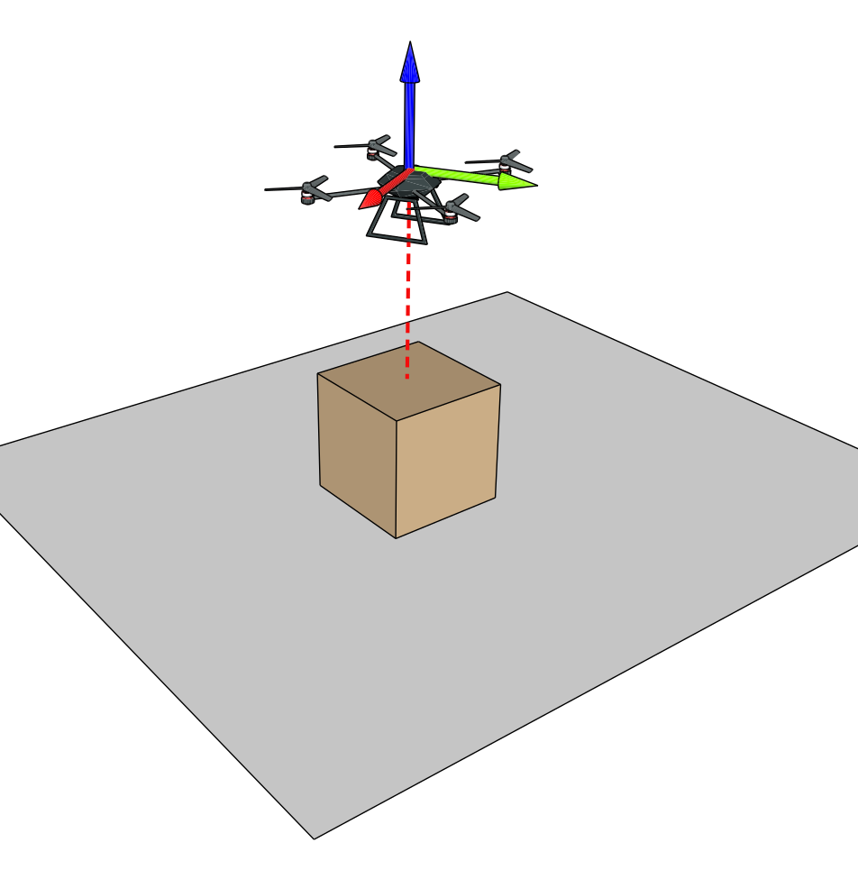

Height Observation Model
Observations to correct the height ar composed by a range sensor + 3D occupancy grid.
The height observation model is then
z = voxel_{z} + range_{distance}
The observation model is then
$$h(\hat{μ})={\hat{μ}}_{z}+b$$
Notes:
In the case of the height correction, a combination of range sensor and 3d occupancy grid is used.
In this case, if the occupancy grid information is available, the observation is composed by the sum of the range sensor distance and the occupancy grid information for the current position of the drone.

Slide 12
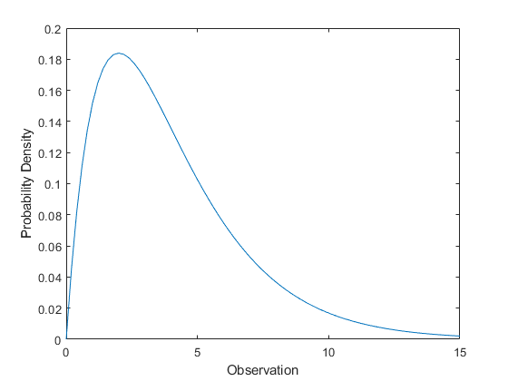

Normalized Estimation Error Squared
Defined as
$$NEES=\left(x−\hat{x}\right)Σ^{−1}\left(x−\hat{x}\right)≤χ_{d,1−α}^{2}$$
Can be performed to check the consistency of the filter
Consistency of the filter is maintained by using observations that statisfy the test:
$$v^{i}=z_{i}−h_{i}\left({\hat{μ}}_{t}\right)$$
$$S=H_{i}{\hat{Σ}}_{t}H_{i}^{T}+Q_{t}$$
$$D_{i}^{2}=v^{i}S^{−1}v^{i}≤χ_{d,1−α}^{2}$$
Notes:
However, some of the observations may be outliers, and that is why we incorporated a way of discarding these measurements
We added a Normalized Estimation Error Squared test, in order to make the algorithm consistent and robust enough to avoid bad measurements.
The NEES test is done before updating the state vector and the covariance matrix.
Here, v_i is the innovation taken from the obtained measurement and the observation model, and S is its covariance.
D2 is used to establish a correspondance between the observed measurement and the landmark features. If D2 is less or equal than the chi2 threshold, this correspondance is verified.
This test is called individual compatibility, and determines whether a subset of observation features are compatible with the observation.

Slide 13
Experiments & Results
Notes:
...

Slide 14
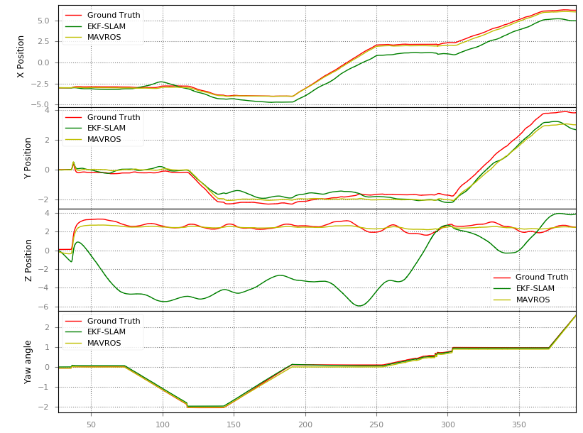
Experiments
The main idea is to understand
the importance of known poles and known and unknown markers in the localization and mapping process
the accuracy of markers' pose estimation
the importance of the NEES test to evaluate measurements and the filter's consistency
Notes:
The experiments were conducted in a simulated environment.
The plot at the right is the odometry-only, so the motion model, compared to the ground truth.
As can be seen, the odometry, the green line, drifts from the ground truth, the red line, over time.
In this plot also the MAVROS estimation is drawn in yellow, and it also drifts over time, however less than the odometry.

Slide 15
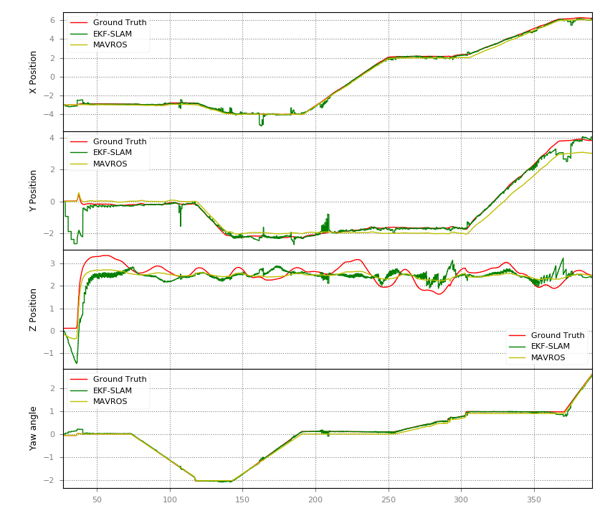
Real observations of poles
Experiment using real observations of poles taken from ROS bag.
Notes:
The first experiment is the Real observations of poles. In this experiment, real range & bearing measurements were used.
It can be seen that the drone follows the ground truth
Also, there is an improvement when compared to the odometry only, in the previous plot.
However, there are some sections of noisy behavior

Slide 16
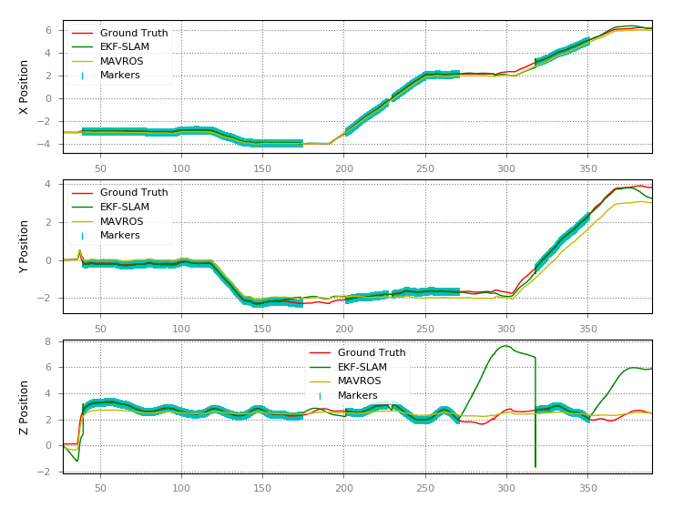
Localization using markers only
This experiment uses known markers (a map) for localization. Hence, no map is build in the process
Notes:
For the second experiment, only known markers were used in the localization process.
The ligth blue sections in the plot are accepted marker observations, which contribute to update the state of the filter.
When no marker is seen, the drone pose drifts or jumps far from the ground truth.
This is due to the velocities delivered by the flight controller, and because there are no landmarks to correct the drone’s position.

Slide 17
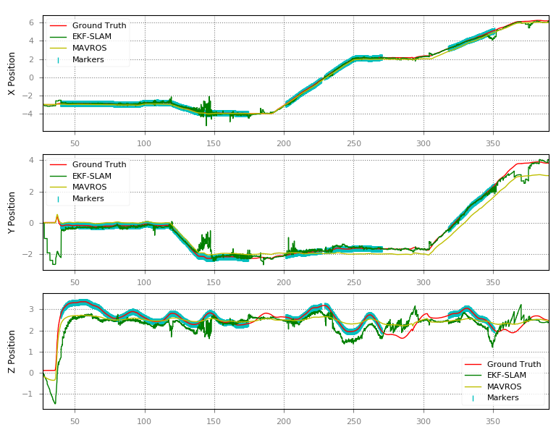
SLAM using poles and markers
This experiment uses markers and poles to localize and build the map.
It had the objective of understanding the importance of both poles and markers in the SLAM situation.
Notes:
The third experiment uses markers and poles to localize while building the map, so a clear SLAM situation.
Again, the light-blue sections are accepted markers’ observations.
It can be see that, compared to the odometry only, it follows the ground truth closer, however, the noise in the signal is higher than when only poles were used.
This behavior has to do with accepted observations that are far from the true marker position, making the filter to diverge from the ground truth.
This problem can be partially solved by tunning the chi2 threshold as I will show later.

Slide 18
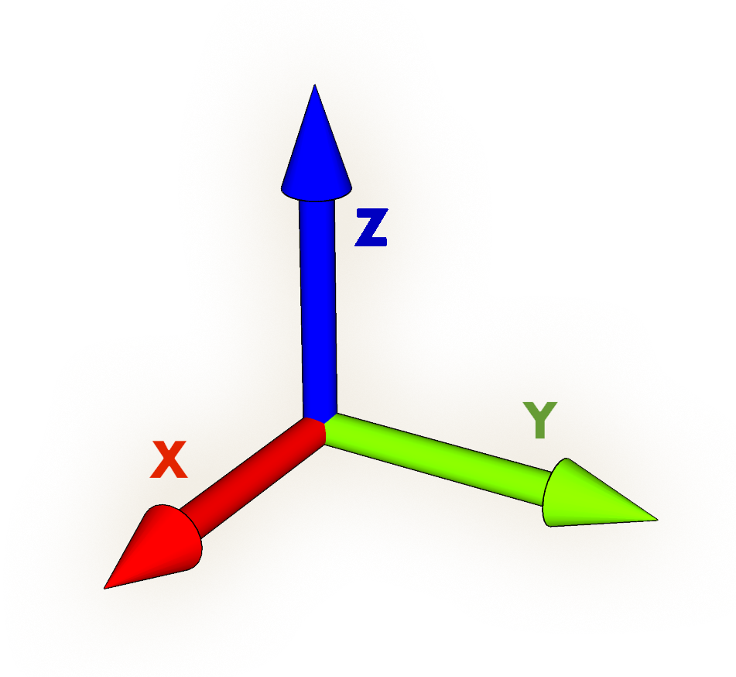
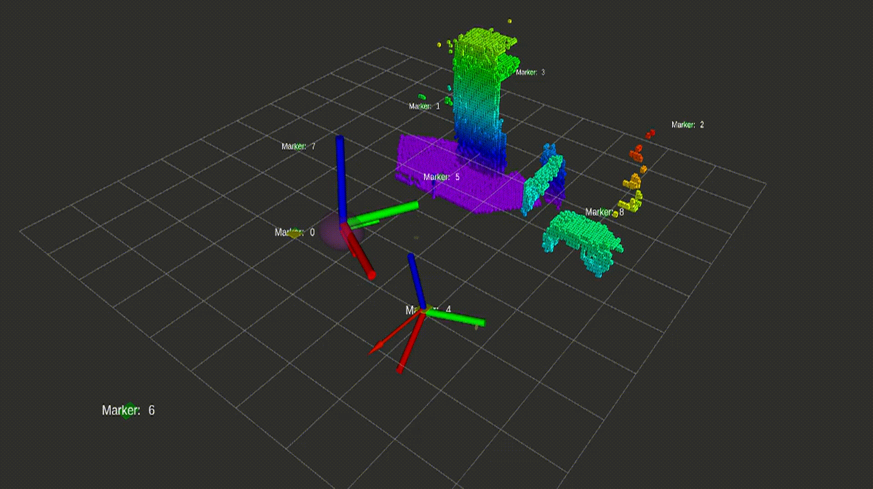
SLAM using poles and markers
Notes:
This video shows what happens around second 150.
The big axis at the top is the ground truth
The axis at the botom represents the marker observation taken from the drone.
The axis that represents the drone is the one circled.
At the begingn the marker axis is completly flipped, and it makes the drone update its pose far from the ground truth
At the end, the marker observation is correct, and the drone pose gets closer to the ground truth.

Slide 19
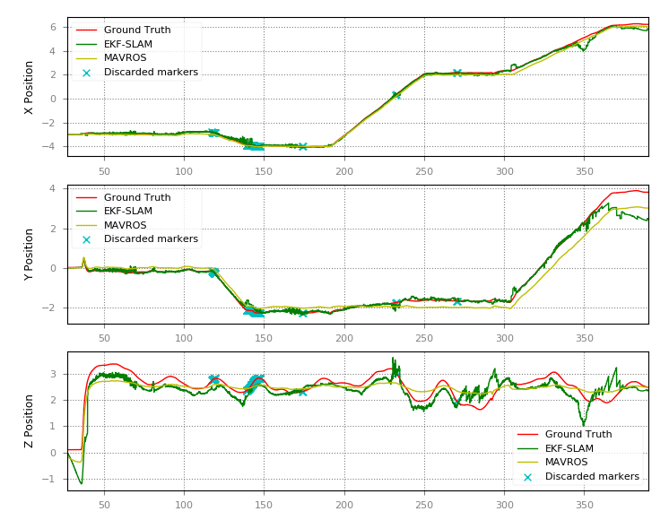


$χ_{α}^{2}$ threshold
So far, was used a threshold that corresponds to 95% of valid measurements. This means that we assume that the 95% of the observations are valid.
This corresponds to $α=0.05$, but this value is the standard one.
What happen with other confidence levels?
For example $α=0.9$
Notes:
As I mentioned, the value of the chi2 threshold is important.
So far, I’ve used a 95% of confidence that measurements are valid.
Nevertheless, if I use a 10% of confidence, the problem I had with bad measurements around second 150 is gone, which as a result introduces a new problem in the Y position after second 350.

Slide 20
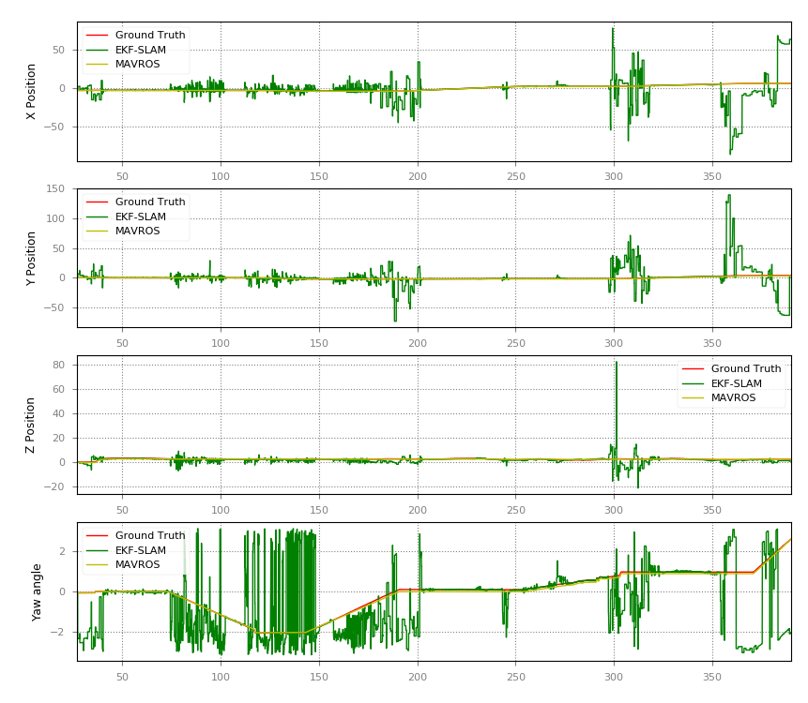
NEES test influence
What happen if no NEES test is used?
Notes:
So what happen if I remove the NEES test?
This plot does not make use of the NEES test, this means that all the observations were used to update the state of the filter.
As can be concluded, the NEES test is fundamental for the consistency of the fliter, so its absence would make the SLAM node unusable

Slide 21
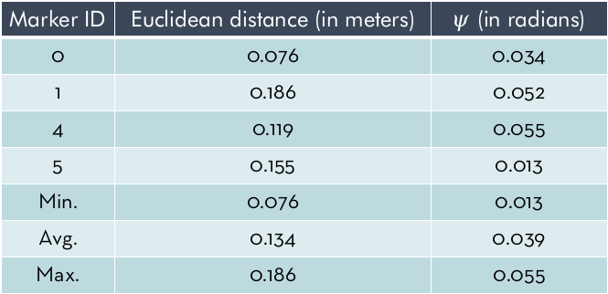
Distance between real and estimated poses
Marker ID | Euclidean distance (in meters) | $ψ$ (in radians)
0 | 0.076 | 0.034
1 | 0.186 | 0.052
4 | 0.119 | 0.055
5 | 0.155 | 0.013
Min. | 0.076 | 0.013
Avg. | 0.134 | 0.039
Max. | 0.186 | 0.055
Measures the distance between the true position of markers and the one estimated by the algorithm in a context of real observations, both for markers and poles.
Notes:
The last experiment shows the estimated pose for discovered markers:
the average euclidean distance is around 13 centimeters
while the average orientation is around 2 degrees.
Although it could be improved, it is a good result for the competition context.

Slide 22
Conclusions
Future work
The first 2 experiments showed the importance of poles and markers in the localization process.
The markers' pose estimation in an SLAM situation is good enough for the competition context.
NEES is fundamental for the consistency of the filter.
Lower confidence of valid measurements implies discarding truly bad measurements, but on the other hand it can discard measurements that can be useful to correct the drone's pose.
The value of α becomes a parameter of the system.
Deploy and test the proposed implementation in the real drone
Fine-tune the noise covariance matrices.
Extensive experimentation with Octomap and range sensor for height update.
Camera self calibration procedure to improve the Z position estimation using poles and markers
Compare the current algorithm with other algorithms like Error-State EKF-SLAM, or UKF-SLAM, and evaluate their performance with the current implementation as baseline
Notes:
To conclude, I can say that both poles and markers are important for the localization process, and the pose estimation for unknown markers is good for the current context.
The NEES test is fundamental in this environment, and while low confidence is important for discarding trully bad measurements, it can discard measurements that might be important for the localization.
Hence, the chi2 threshold becomes a new parameter of the system.
On the other hand, future development could be done.
As mentioned, all the experiments were done in a simulated enviroment, and they should be run in the real drone.
Moreover, it is important to fine-tune the noise matrices and chi2 thresholds.
Finally, this implementation can be used as a baseline for comparing different SLAM approaches.

Slide 23
Thank you! any question?
Notes:
Thank you very much for your time.

